Slide 2
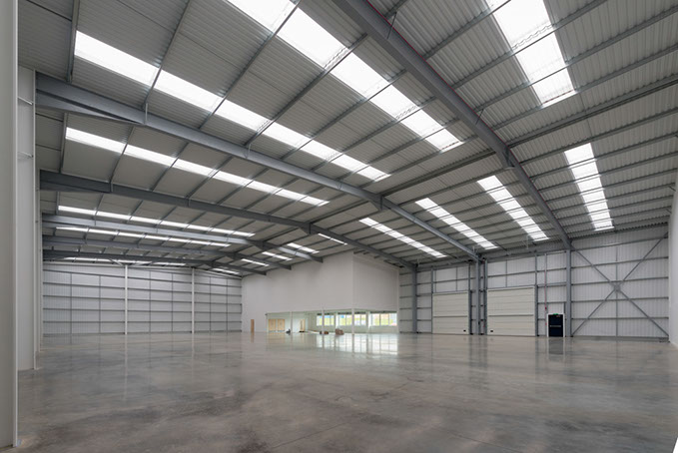
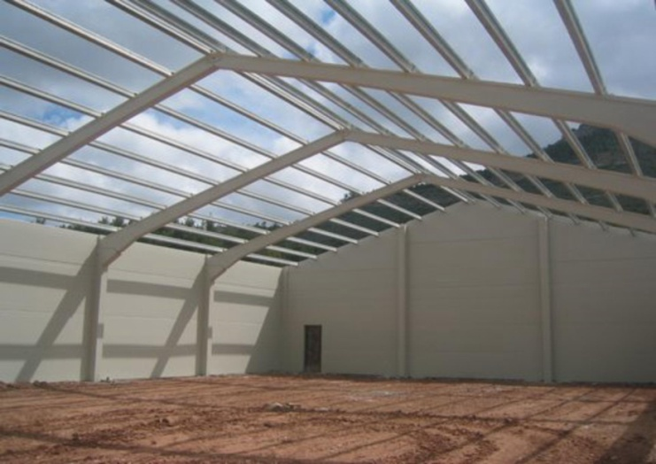
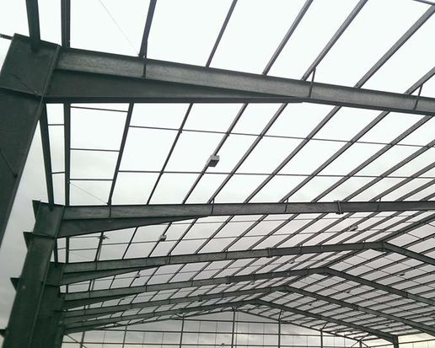
Himalaya College of Engineering
Department of Architecture
Fireplaces and Chimneys
AR 604 Building Construction IV
1 Poush, 2072
Lecturer- Ar. Yam Rai

Slide 3
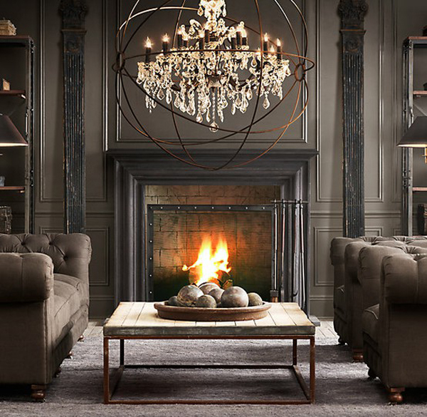
Introduction

Slide 4
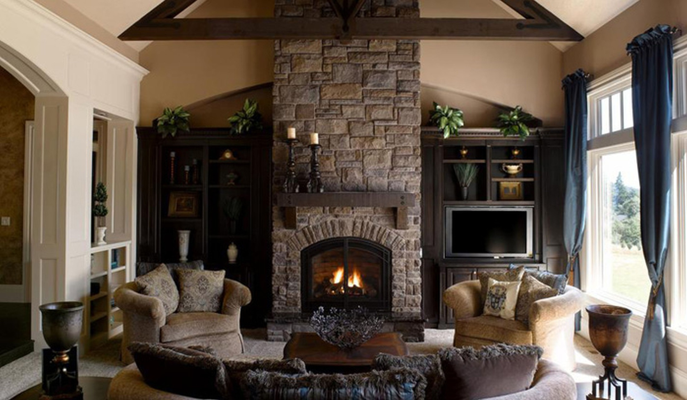
Introduction

Slide 5
Introduction
Traditional method of providing heat in a domestic building
Use is declining because of low efficiency compared to modern heating appliances
Combustible fuels like coal, wood require means of conveying the products of combustion away from the fireplace

Slide 6
Terminology
Fireplace
Area in which combustion of fuel takes place
May be in the form of an open space with a grate in which wood or coal is burnt or
Free standing appliance such as combustion stove, oil burning appliance, gas boiler etc.
Chimney
Fabric surrounding the flue and providing it with the necessary strength and protection

Slide 7
Terminology
Flue
This is strictly a void through which the products of combustion pass.
Formed by lining the inside of a chimney with a suitable lining material to give protection to the chimney fabric from the products of combustion.
To improve the efficiency of a flue > chimney to be placed on an internal wall > reduce the heat loss to the outside air > reduce risk of condensation within the flue
Condensation could cause corrosion of the chimney fabric due to sulphur compounds > by product of combustion

Slide 8
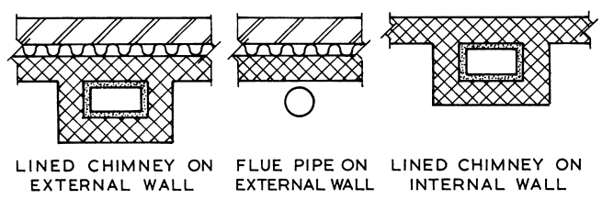
Terminology
Flue

Slide 9
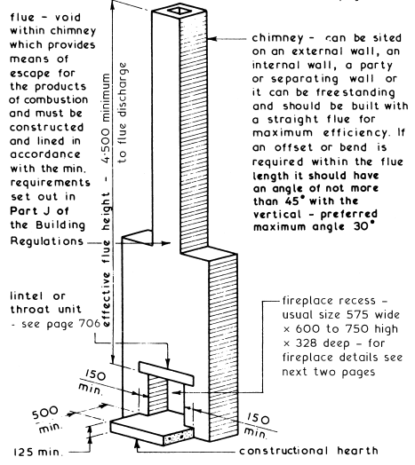
Open fire places
Components
Hearth
Fire place recess
Chimney
Flue
Terminal

Slide 10
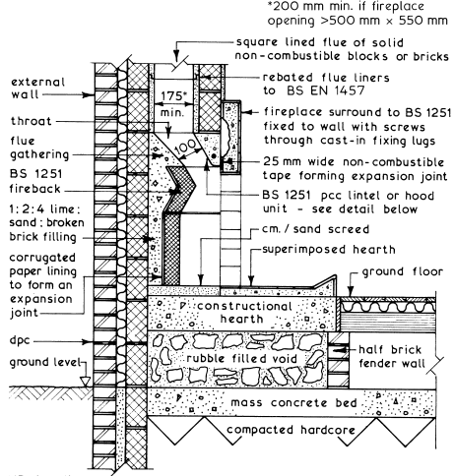
Open fire places

Slide 11
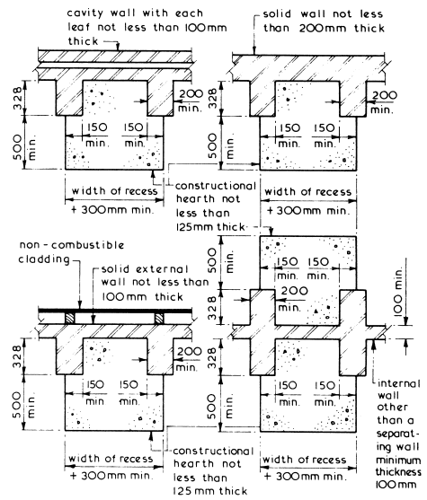
Open Fireplace Recess

Slide 12
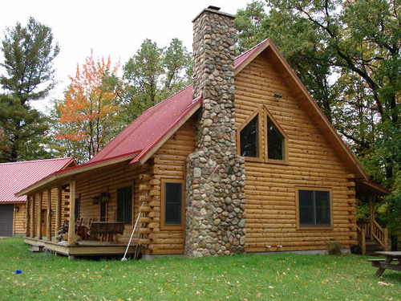
Chimney Construction

Slide 13
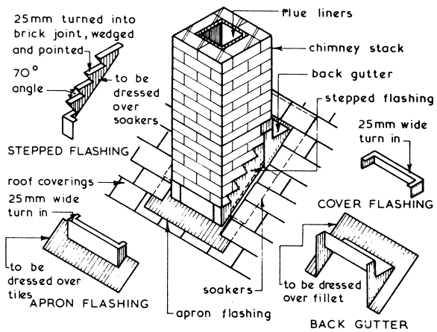
Chimney Construction

Slide 14
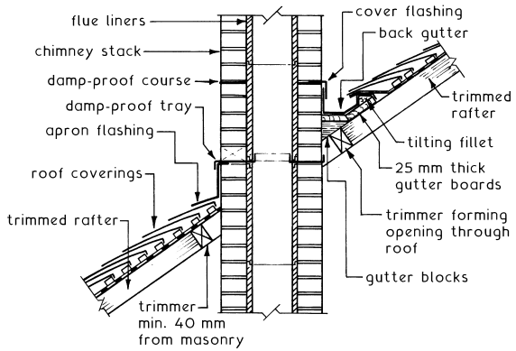
Chimney Construction

Slide 15
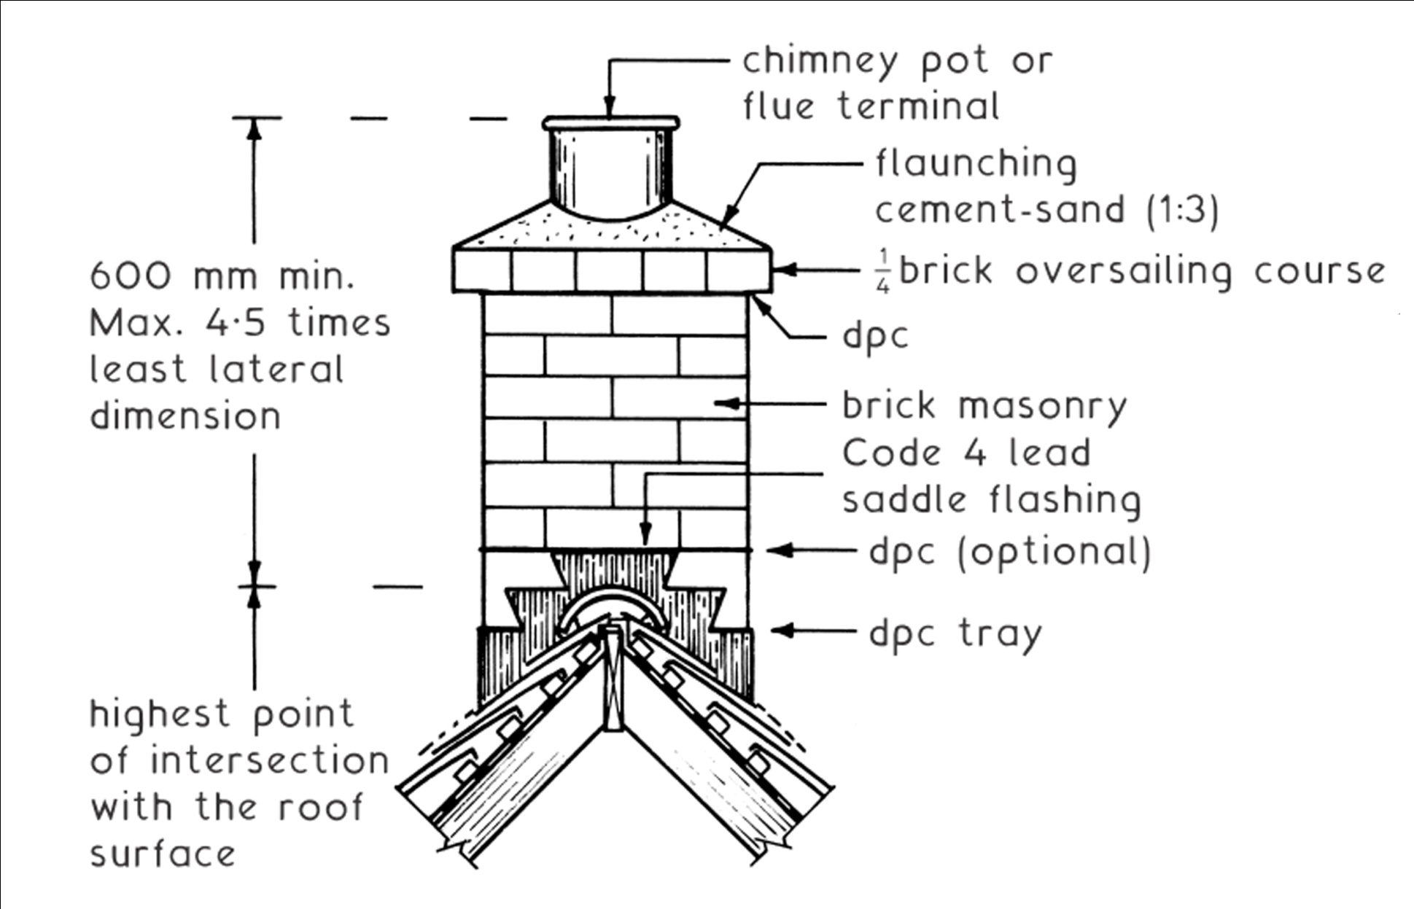
Chimney Construction
Typical chimney outlet

Slide 16
Chimney Construction
Clay bricks – Frost resistant quality
Mortar – Strong mix of cement and sand, Cement to be specified as sulphate resisting because of the presence of soluble sulphates in the flue gas condensation
Chimney pot - The pot should be firmly bedded in at least 3 courses of brickwork to prevent it being dislodged in high winds
Flashings and dpcs - Essential to prevent water which has permeated the chimney, penetrating into the building

Slide 17
Thank you...

